Slide 1
Enhancing Bank Robustness through Dynamic Control of Leverage (DCL) in Contingent Convertible Bonds (CoCos): A Case Study Analysis

Slide 2
Overview
Contingent Convetible bonds (CoCos)
Sas
hh
r
(pre 2008 -> 2008 response (BIS, flannery, Lloyds & Credit Suisse issuances) -> (Change in trigger popularity) -> 2023 Credit Suisse collapse -> criticisms of CoCos
DCL bonds (Describe the triggers)
Case studies (Credit Suisse, Deutsche Bank, Lehman)
Minimum Leverage adjustments
Time gained as a design objective

Slide 3
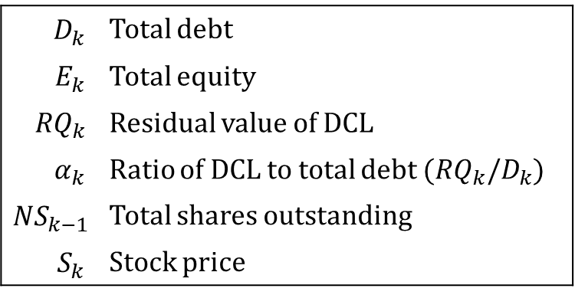

Dynamic Control of Leverage (DCL)
$$L_{k}=\frac{D_{k}}{D_{k}+E_{k}}≈\frac{RQ_{k}}{RQ_{k}+α_{k}∙NS_{k−1}∙S_{k}}$$
Variables:
$$D_{k}$$ | Total debt
$$E_{k}$$ | Total equity
$${RQ}_{k}$$ | Residual value of DCL
$$α_{k}$$ | Ratio of DCL to total debt (${RQ}_{k}/D_{k}$)
$${NS}_{k−1}$$ | Total shares outstanding
$$S_{k}$$ | Stock price
(Figure showing leverage, RQ_k and market cap)

Slide 4
Theoretical simulations

Slide 5
Case studies
Credit Suisse ()
Detusche Bank ()
Lehman Brothers ()

Slide 6
Credit Suisse

Slide 7
Deutsche Bank

Slide 8
Lehman Brothers

Slide 9
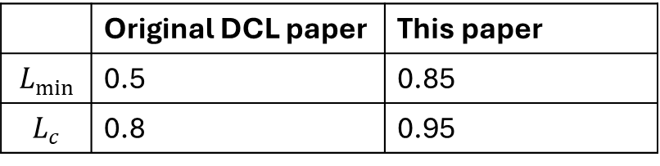
Difference from the original paper
 | Original DCL paper | This paper
$$L_{min}$$ | 0.5 | 0.85
$$L_{c}$$ | 0.8 | 0.95

Slide 10
Results of higher leverage thresholds
Leverage adjustment asymmetry
Minimum leverage adjustments require much larger top-up loan issuances

Slide 11
Solving leverage asymmetry

Slide 12
Discussion – Time as a design objective

Slide 13
Thanks

Slide 14
Bibliography

